Slide 1
Sprint Review
Sprint 2: Python WebScraping on a Virtual Machine

Slide 2
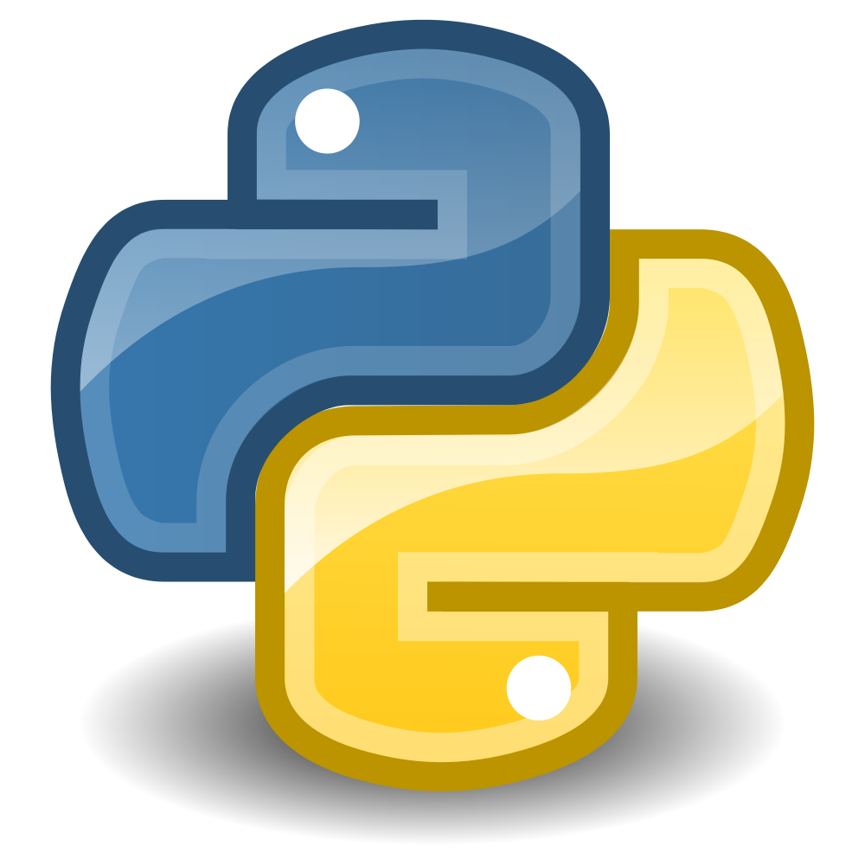
Notes:
The first is creating my virual machine droplet, the second is installing jupyter notebook onto it, and the third was writing a python script within it

Slide 3

Notes:
What is digital ocean? Cloud server, basically its my new computer, but I don’t really have a desktop interface to work on it with

Slide 4
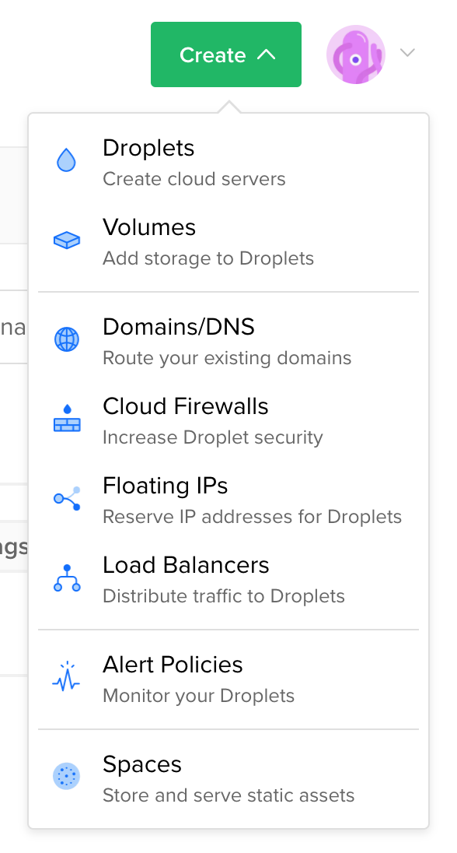
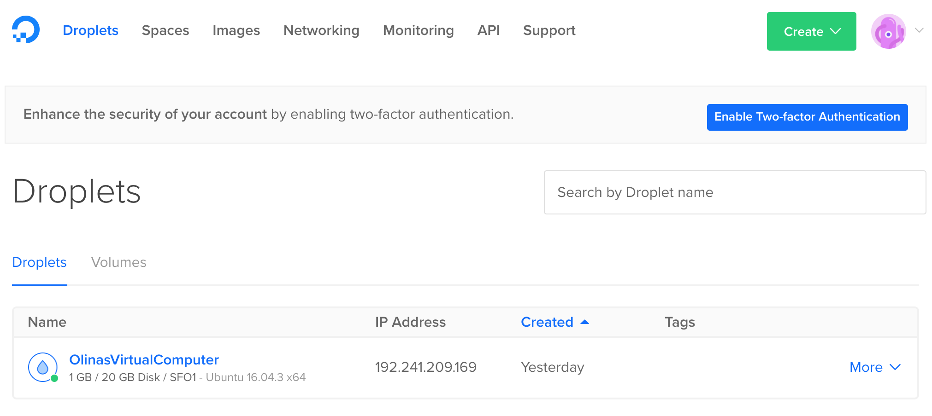
Notes:
Installing digital ocean

Slide 5
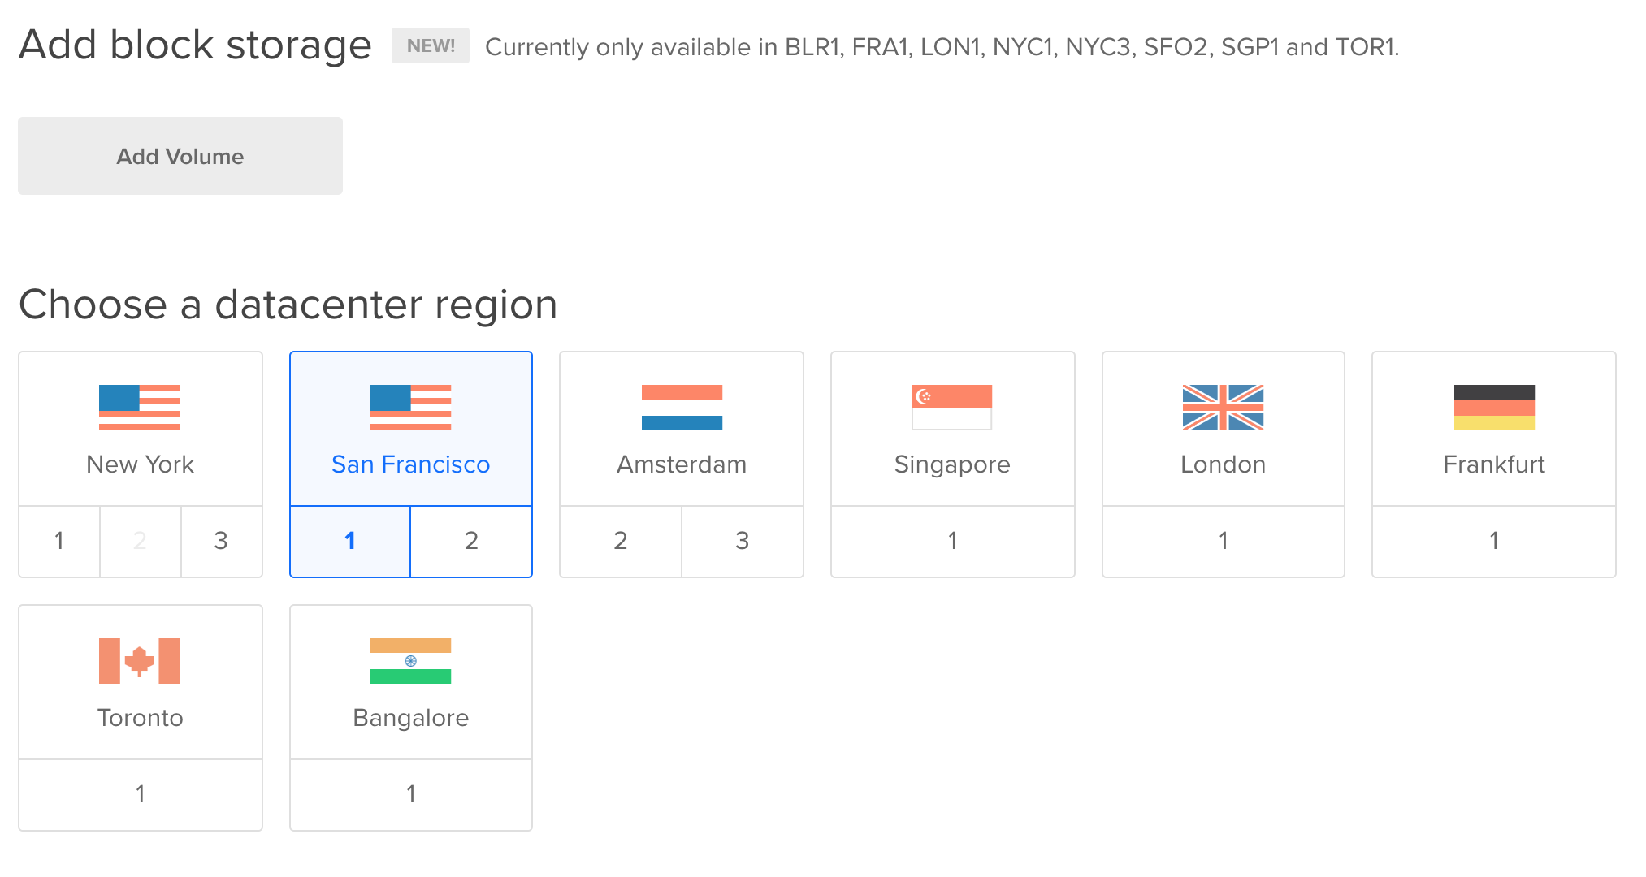
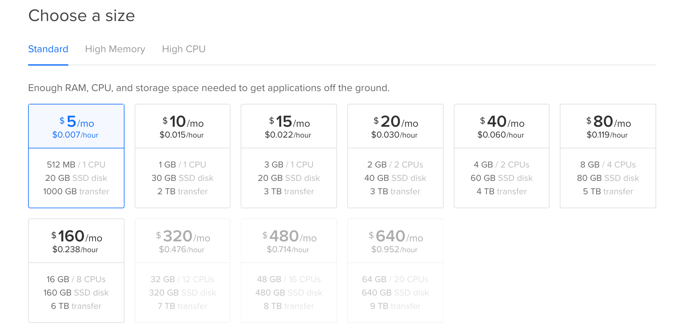
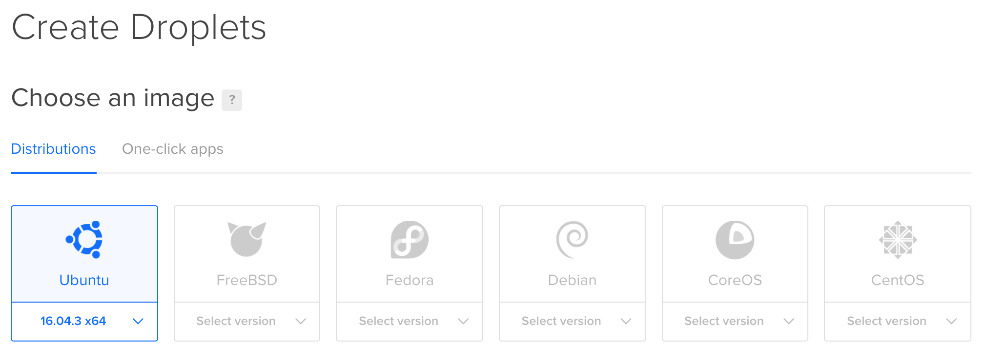

Slide 6

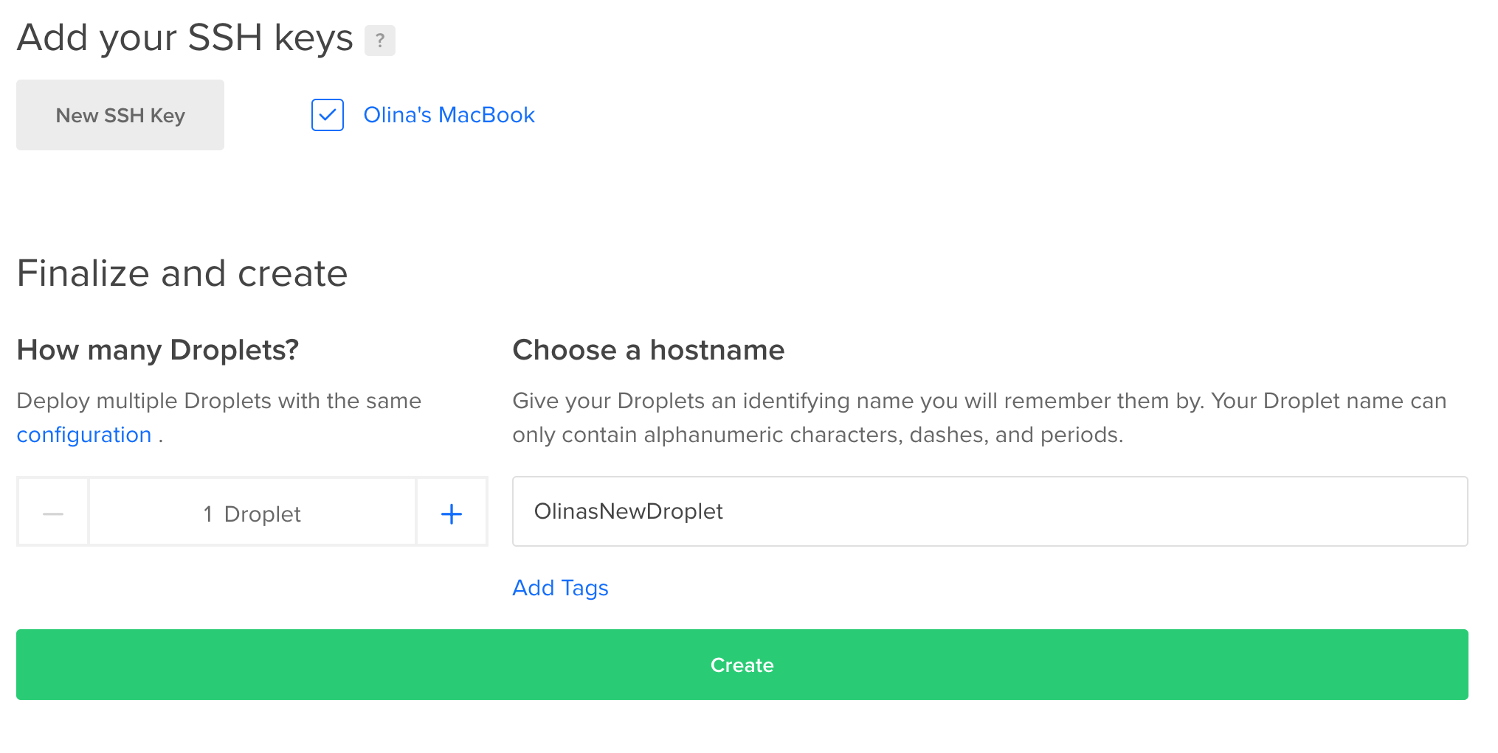

Slide 7
Notes:
How to install jupyter notebook to run ipython

Slide 8
http://192.241.209.169/tree/Work

Slide 9
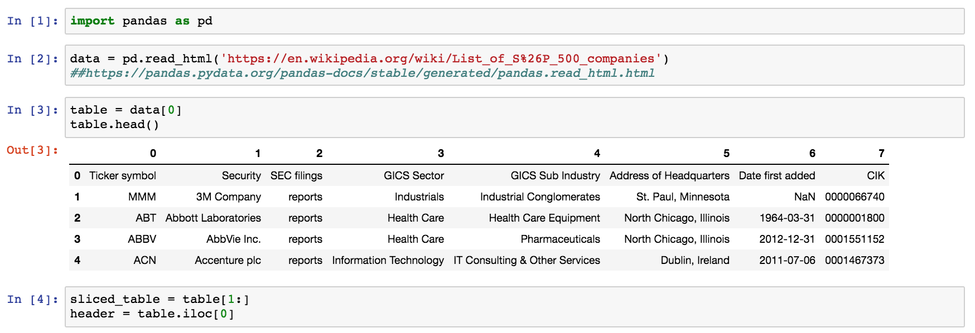

Slide 10
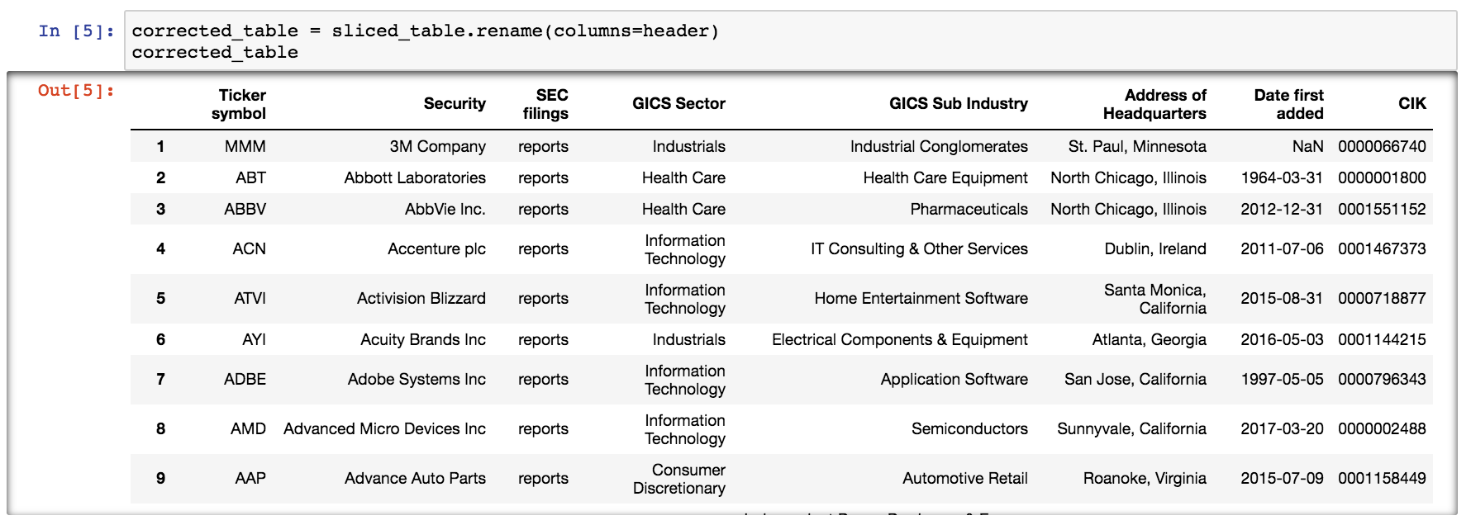

Slide 11
Thoughts…

Slide 12
Fin

